Slide 1
Spring Introduction

Slide 2
Module Overview
In this Module, we will learn the following:
Architecture
Environment Setup
Hello World Example

Slide 3
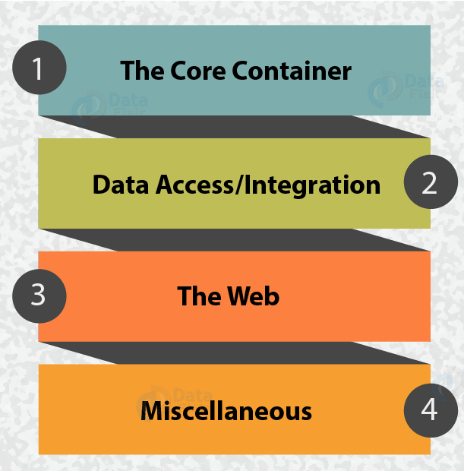
Architecture
Spring Framework Architecture
The core concept for developing Spring Framework was to make it a one-stop solution where you can integrate and use the modules according to the need of your application.
This modularity of Spring is due to the architecture of Spring.
There are about 20 modules in the Spring framework which are being used according to the nature of the application.

Slide 4
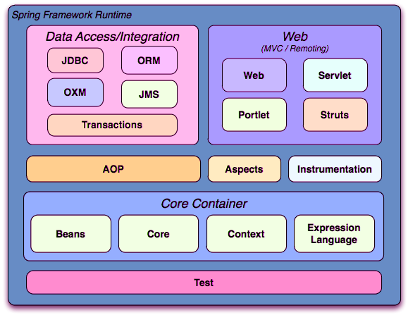
Modules of Spring Architecture
The Spring Framework Architecture contains 4 main modules namely:
Core Container
Data Access/Integration
The Web Container
AOP and Instrumentation
Test

Slide 5
Spring Modules contd…
Core Container
It consists of the Core, Beans, Context, and Expression Language modules.
Core and Beans modules:
The Core and Beans modules provide the fundamental parts of the framework, including the IoC and Dependency Injection features.
The BeanFactory is a implementation of the factory pattern. It removes the need for programmatic singletons and allows you to decouple the configuration and specification of dependencies from your actual program logic.
Context modules:
The Context module builds on the solid base provided by the Core and Beans modules: it is a means to access objects in a framework-style manner that is similar to a JNDI registry.
Expression Language modules:
The Expression Language module provides a powerful expression language for querying and manipulating an object graph at runtime.
Notes:
Context modules:
The Context module inherits its features from the Beans module and adds support for internationalization (using, for example, resource bundles), event-propagation, resource-loading, and the transparent creation of contexts by, for example, a servlet container. The Context module also supports Java EE features such as EJB, JMX ,and basic remoting. The ApplicationContext interface is the focal point of the Context module.
Expression Language modules
It is an extension of the unified expression language (unified EL) as specified in the JSP 2.1 specification.
The language supports setting and getting property values, property assignment, method invocation, accessing the context of arrays, collections and indexers, logical and arithmetic operators, named variables, and retrieval of objects by name from Spring's IoC container. It also supports list projection and selection as well as common list aggregations.

Slide 6
Spring Modules contd…
Data Access/Integration
The Data Access/Integration layer consists of the JDBC, ORM, OXM, JMS and Transaction modules.
JDBC
The JDBC module provides a JDBC-abstraction layer that removes the need to do tedious JDBC coding and parsing of database-vendor specific error codes.
ORM
The ORM module provides integration layers for popular object-relational mapping APIs, including JPA, JDO, Hibernate, and iBatis.
OXM
The OXM module provides an abstraction layer that supports Object/XML mapping implementations for JAXB, Castor, XMLBeans, JiBX and XStream.
JMS
The Java Messaging Service (JMS) module contains features for producing and consuming messages.
Transaction
The Transaction module supports programmatic and declarative transaction management for classes that implement special interfaces and for all your POJOs (plain old Java objects).
Notes:
ORM
Using the ORM package you can use all of these O/R-mapping frameworks in combination with all of the other features Spring offers, such as the simple declarative transaction management feature.

Slide 7
Spring Modules contd…
The Web Container
The Web Container/layer consists of the Web, Web-Servlet, Web-Struts, and Web-Portlet modules.
Web module
Spring's Web module provides basic web-oriented integration features such as multipart file-upload functionality and the initialization of the IoC container using servlet listeners and a web-oriented application context.
Web-Servlet
The Web-Servlet module contains Spring's model-view-controller (MVC) implementation for web applications.
Spring's MVC framework provides a clean separation between domain model code and web forms, and integrates with all the other features of the Spring Framework.
Web-Struts
The Web-Struts module contains the support classes for integrating a classic Struts web tier within a Spring application.
Web-Portlet
The Web-Portlet module provides the MVC implementation to be used in a portlet environment and mirrors the functionality of Web-Servlet module.
Notes:
Web module:
It also contains the web-related parts of Spring's remoting support.
Web-Strusts;
Note that this support is now deprecated as of Spring 3.0. Consider migrating your application to Struts 2.0 and its Spring integration or to a Spring MVC solution.

Slide 8
Spring Modules contd…
AOP and Instrumentation
Spring's AOP module provides an AOP Alliance-compliant aspect-oriented programming implementation, and Integration module
AOP Module:
The separate Aspects module provides integration with AspectJ.
Instrumentation module:
The Instrumentation module provides class instrumentation support and classloader implementations to be used in certain application servers.
Notes:
AOP module
E.g. method-interceptors and pointcuts to cleanly decouple code that implements functionality that should be separated.
AOP alliance compliant aop help you to use source-level metadata functionality, you can also incorporate behavioral information into your code, in a manner similar to that of .NET attributes.

Slide 9
Spring Modules contd…
Test
The Test module supports the testing of Spring components with JUnit or TestNG.
It provides consistent loading of Spring ApplicationContexts and caching of those contexts.
It also provides mock objects that you can use to test your code in isolation.

Slide 10
Environment Setup

Slide 11
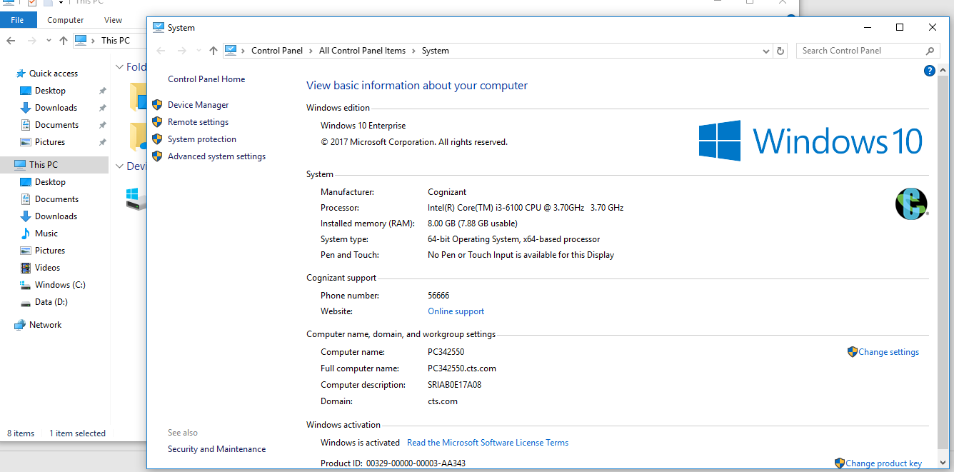
Environment Setup
Step 1 - Setup Java Development Kit (JDK)
You can download the latest version of java from below link.
https://www.oracle.com/technetwork/java/javase/downloads/index.htm
Step 2- Right Click on My Computer => Properties=>Click on Advanced system Settings

Slide 12
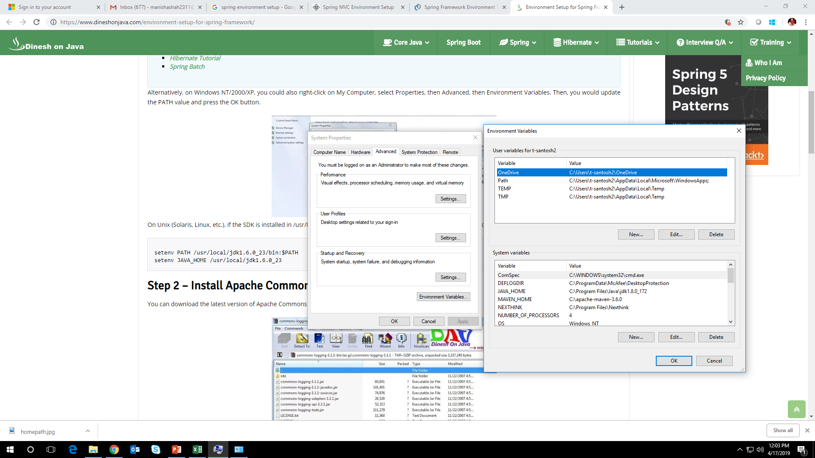
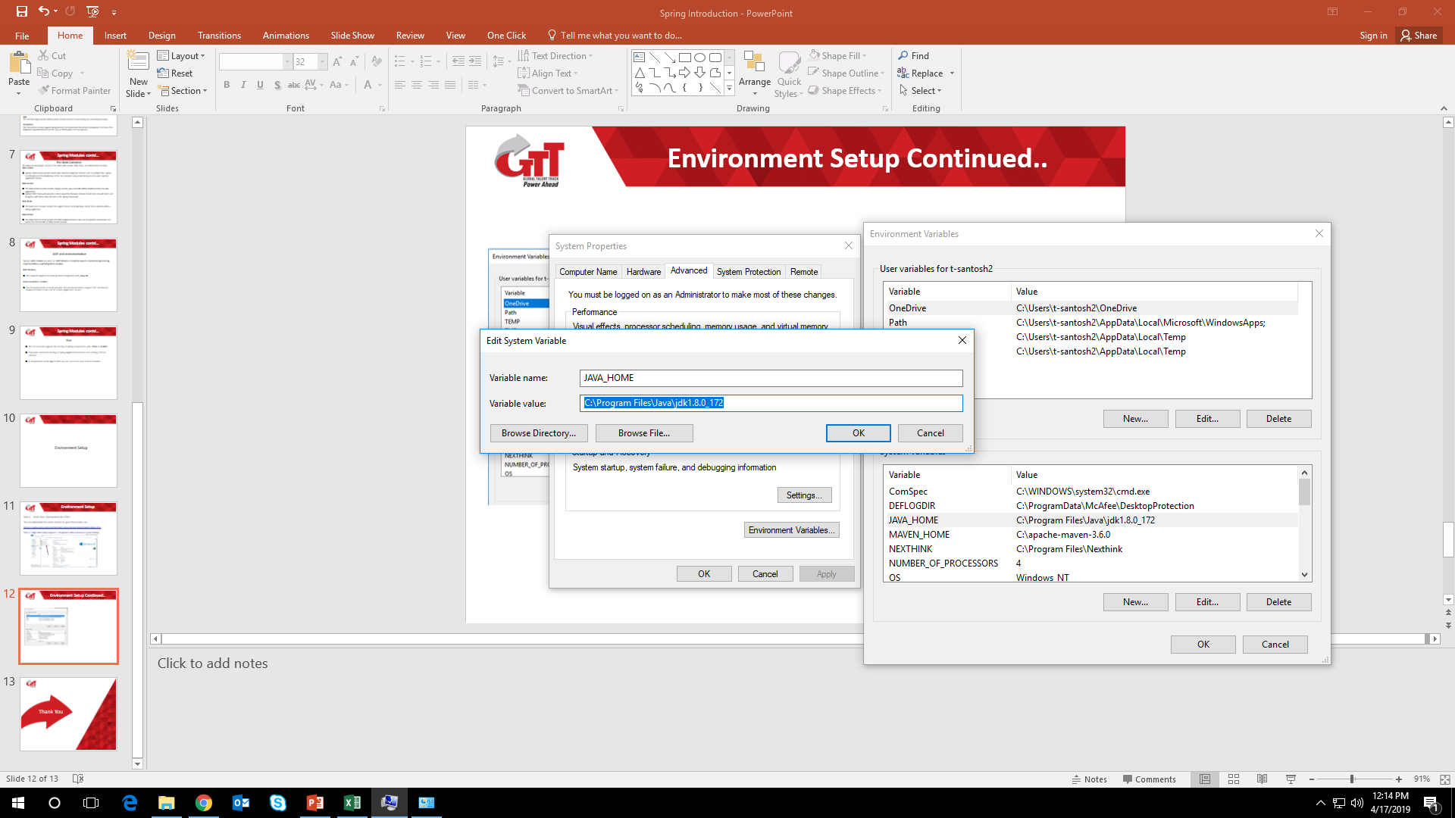
Environment Setup Continued..
Step 3- Environment variables=>System Variables=> Variable name as =>JAVA_HOME=>and value as =>your jdk folder location path. Click on OK.

Slide 13
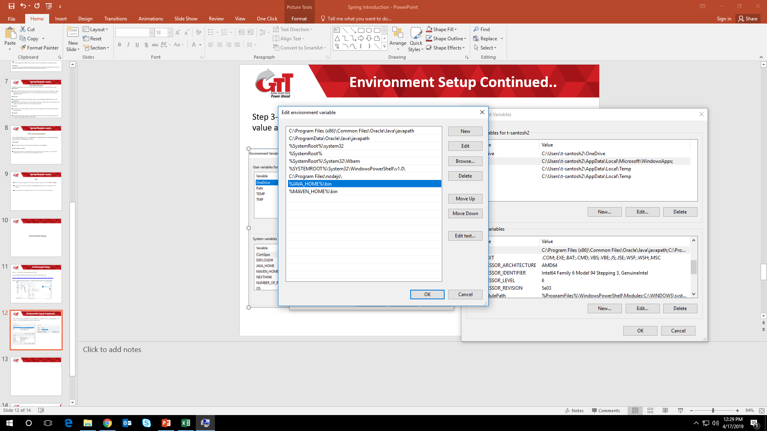
Environment Setup Continued..
Step 4: Edit Path variable and add the value to Path variable %JAVA_HOME%\bin and click on OK.

Slide 14
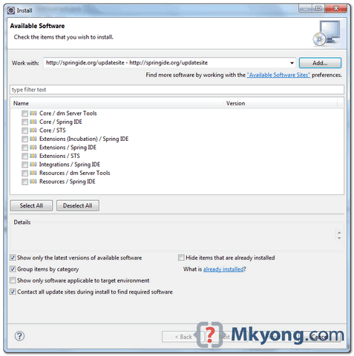
Environment Setup Continued..
Spring Environment setup for Eclipse
Step 1:
Open Eclipse IDE, select Help =>Install New Software. Type http://springide.org/updatesite. Select those Spring IDE features we want to install.
It will take long time to install updates and then restart Eclipse after finished.

Slide 15
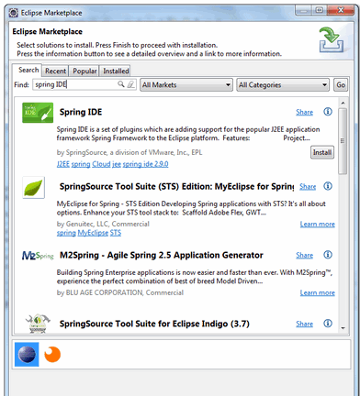
Environment Setup Continued..
Step 2.: Eclipse Marketplace
This way we can use since we need not to remember the long Spring ide update URL. In Eclipse IDE, select Help=> Eclipse Marketplace, type Spring IDE, follow the wizard to finish the installation.
Take long time to install and restart Eclipse after finished.

Slide 16
Hello World Example
To run Simple Example we need to download the Spring framework library..
Download the latest version of Spring framework binaries from https://repo.spring.io/release/org/springframework/spring.
In this example we have used spring-framework-4.1.6.RELEASE-dist.zip

Slide 17
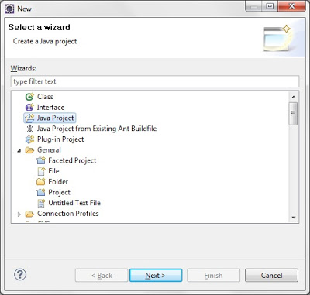
Hello World Example
Step 1 - Create Java Project
Open eclipse select File => New => Project => Java Project. Now name the project as HelloUser as follows −

Slide 18
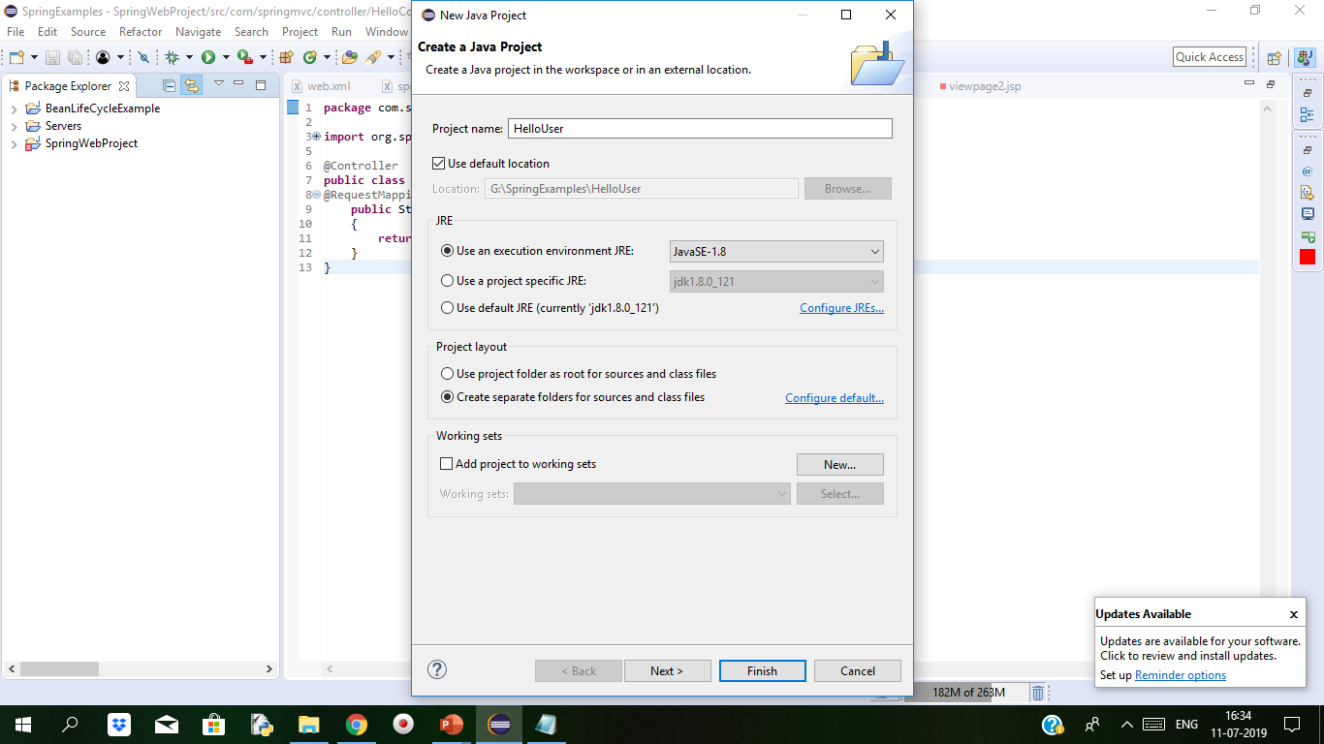
Hello World Example
Step 2: Click on Next

Slide 19
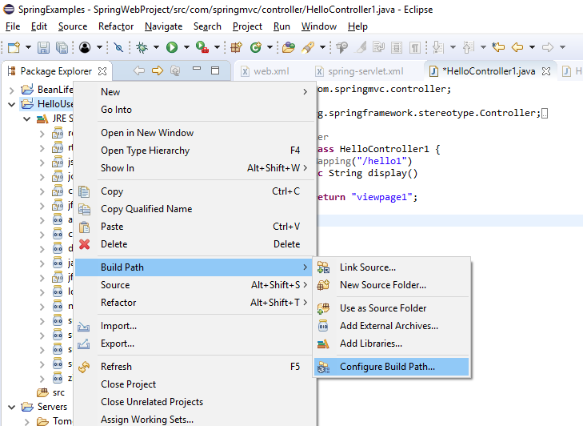
Hello World Example
Step 3 – Add below libraries
Right click on project=> Build Path => Configure Build Path

Slide 20
Hello World Example
Click on Add External JARs button in Libraries tab to add the following JARs from Spring Framework.
commons-logging-1.1.1
spring-aop-4.1.6.RELEASE
spring-aspects-4.1.6.RELEASE
spring-beans-4.1.6.RELEASE
spring-context-4.1.6.RELEASE
spring-context-support-4.1.6.RELEASE
spring-core-4.1.6.RELEASE
spring-expression-4.1.6.RELEASE

Slide 21
Hello World Example
Code for User.java
package com.springbasic;
public class User {
private String userName;
public void setUserName(String username)
{
this.userName=username;
}
public String getUserName()
{
return userName;
}
}

Slide 22
Hello World Example
Step 3 - Create Source Files
create actual source files under the HelloSpring project. First we need to create a package called com.test.hello. To do this, right click on src in package explorer section and follow the option − New → Package.
Next we will create HelloWorld.java and MainApp.java files under the com com.test.hello package.
Code for UserMainApp.java
package com.springbasic;
import org.springframework.context.ApplicationContext;
import org.springframework.context.support.ClassPathXmlApplicationContext;
public class UserMainapp {
public static void main(String[] args) {
// TODO Auto-generated method stub
ApplicationContext context=new ClassPathXmlApplicationContext("userBean.xml");
User user=(User)context.getBean("user1");
System.out.println("Welcome..."+ user.getUserName());
}
}

Slide 23
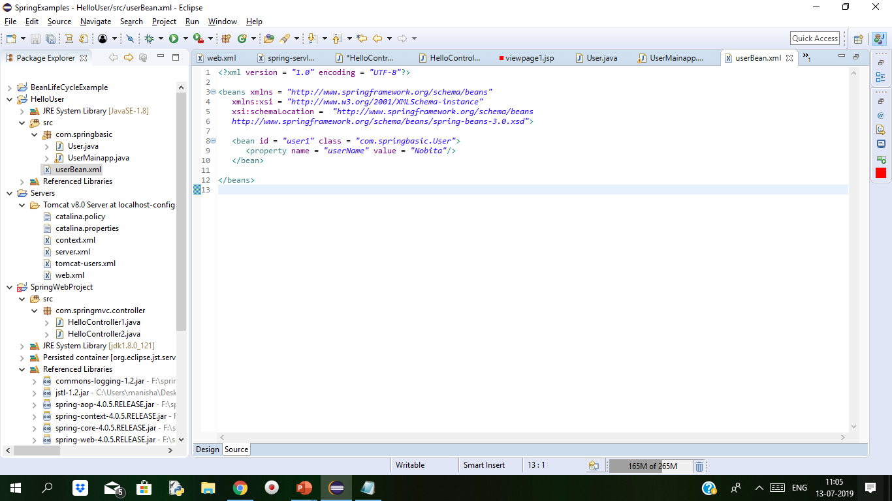
Hello World Example
In first line in generated application context from ClassPathXmlApplicationContext() API. This API loads beans configuration file and eventually based on the provided API, it creates and initializes all the objectswhich is mentioned in the configuration file.
In the second line getBean()method of generated context is used to get the necessary bean. The method uses bean’s id for a generic object, which then casted to the class object. Once the object is created we can call any method of the class.
Step 4 - Create Bean Configuration Filea
We need to create a Bean Configuration file which is an XML file and acts as a joint that combines the classes with each other. This file needs to be created under the src directory
Notes:
The Beans.xml is used to assign unique IDs to different beans and to control the creation of objects with different values without impacting any of the Spring source files. For example, using the following file you can pass any value for "message" variable and you can print different values of message without impacting HelloWorld.java and MainApp.java files. Let us see how it works −

Slide 24
Hello World Example
<?xml version = "1.0" encoding = "UTF-8"?>
<beans xmlns = "http://www.springframework.org/schema/beans"
xmlns:xsi = "http://www.w3.org/2001/XMLSchema-instance"
xsi:schemaLocation = "http://www.springframework.org/schema/beans
http://www.springframework.org/schema/beans/spring-beans-3.0.xsd">
<bean id = "user1" class = "com.springbasic.User">
<property name = "userName" value = "Nobita"/>
</bean>
</beans>
Notes:
Spring application gets loaded into the memory, Framework makes use of the above configuration file to create all the beans defined and assigns them a unique ID as defined in <bean> tag. You can use <property> tag to pass the values of different variables used at the time of object creation.

Slide 25
Hello World Example
Step 5 - Running the Program
Now Right click on Project and Run the application as Java Application.
Will see the following output on the console.
Your Message : Hello World!

Slide 26

Thank You

